Slide 1
Forecasting Commercial Truck Sales with Time Series Analysis
Austin Noriega

Slide 2
Table of Contents
Overview
Executive Summary
Data and Findings
Conclusions and Further Considerations

Slide 3
Overview
This report encompasses sales data gathered from 2003-2014
Multiple models were evaluated by RMSE (root mean squared error) to find the best model to forecast
A 5-year forecast was made to see company sale's trends in the short/long run

Slide 4
Executive Summary
Overall vehicle sales for the dealership are up year after year
Forecasted sales are to increase by 36% over the next 5 years
Most sales are currently and forecasted to made in the summer

Slide 5
Data Overview
Sales data by month over 11 years (2003 – 2014) of a commercial Truck dealership
Multiple models were made to best forecast the next 5 years of sales
All models were evaluated by the Root Mean Squared Error (RMSE)
Model Name | RMSE
Best AR model: (1,0,0) | 306.142
Best ARMA model: (3,0,3) | 232.039
Best ARIMA model: (3,1,3) | 212.592
Best SARIMA model: (1,0,1) x (1,0,1,12) | 84.268
Best Exponential Smoothing Model: Holt's Winter Seasonal | 43.4

Slide 6
Findings
Some of the main findings are:
Monthly sales have been up year after year
Peak sales occur in the months of May – August
Projected sales will increase 36% on average over the next 5 years

Slide 7
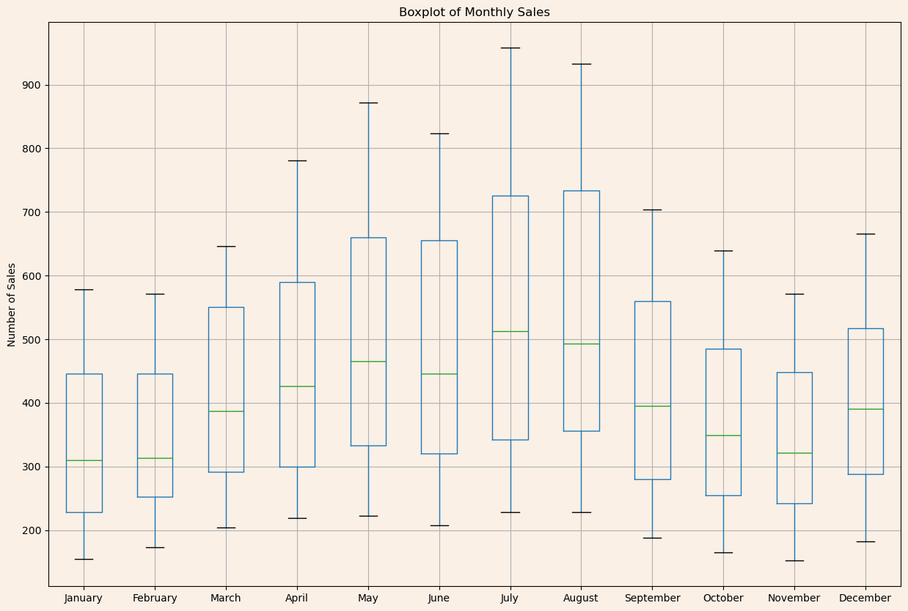
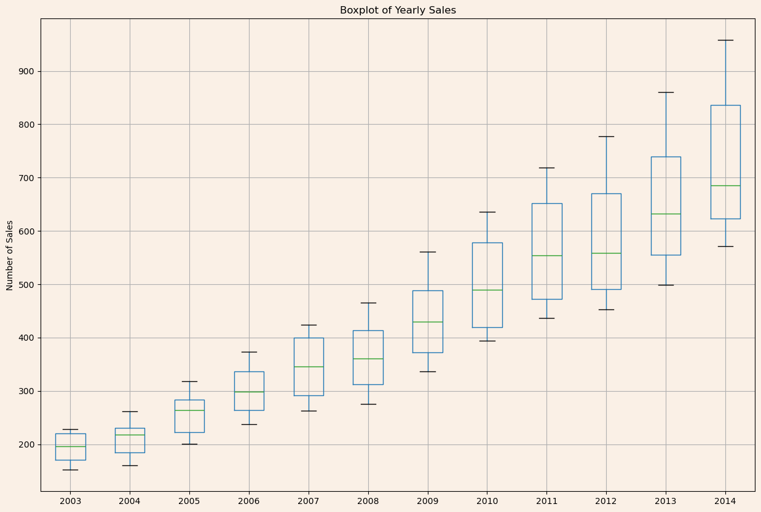
Chart of Findings

Slide 8
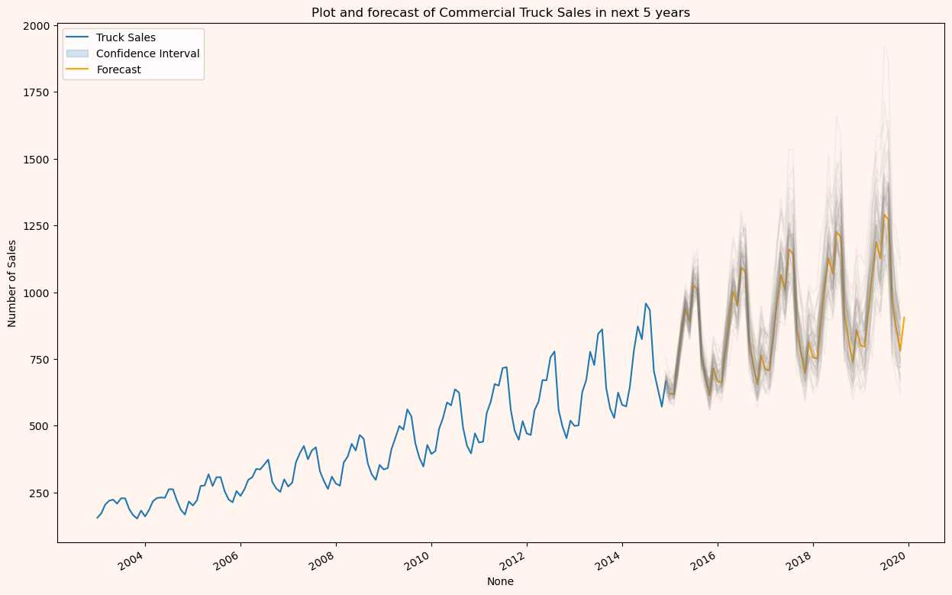
Charts of Findings (cont.)

Slide 9
Conclusion and Further Considerations
After reviewing the data, projections show a consistent increase in sales over the next 5 years
Promotional materials should be increased leading up to the highest sales months (Summer)
Further research can be done to find further insights, such as:
Days in which sales are the highest
Willingness to buy analysis at various price points
How to generate more sales in the months that are lowest

